Slide 1
ONLINE HOME RENTAL SYSTEM FOR APARTMENT COMPLEXES
Team C

Slide 2
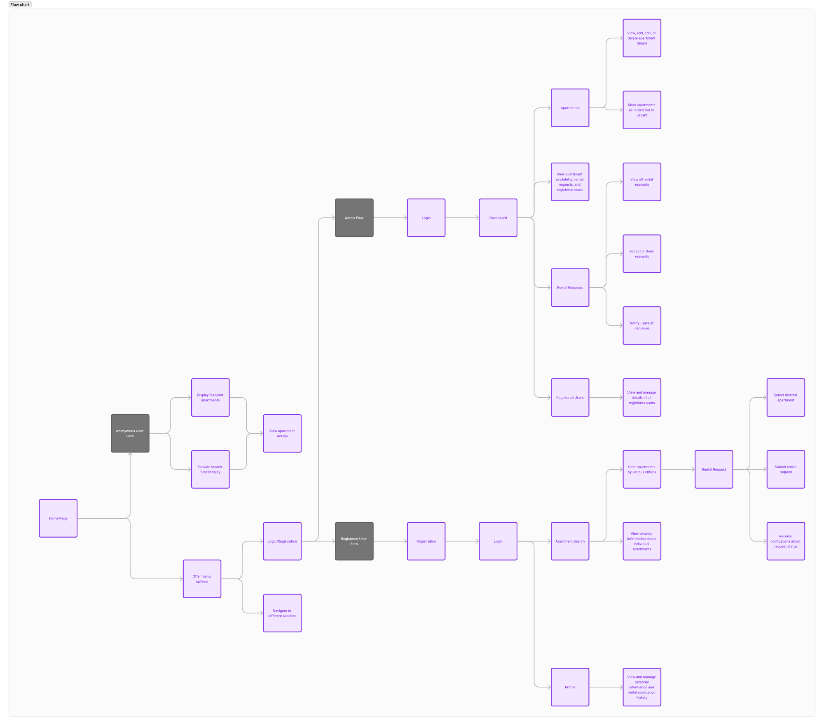
Data Model

Slide 3
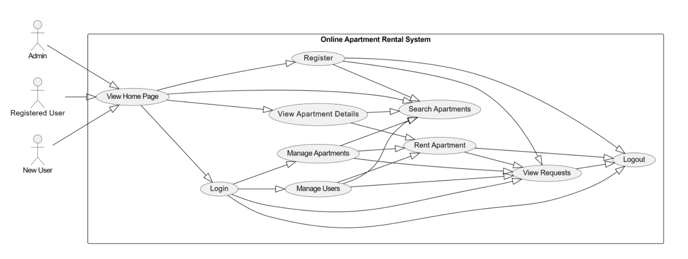
Use Case Diagram

Slide 4
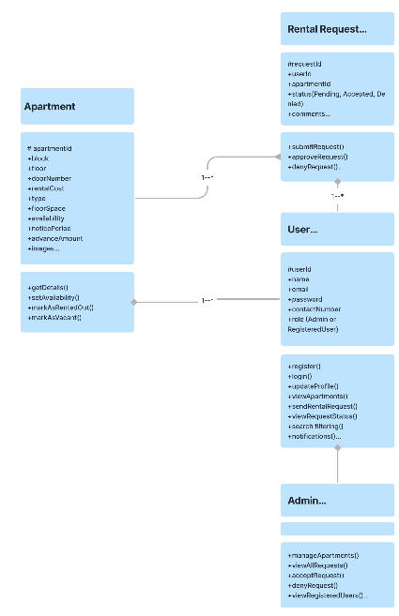
Class Diagram

Slide 5
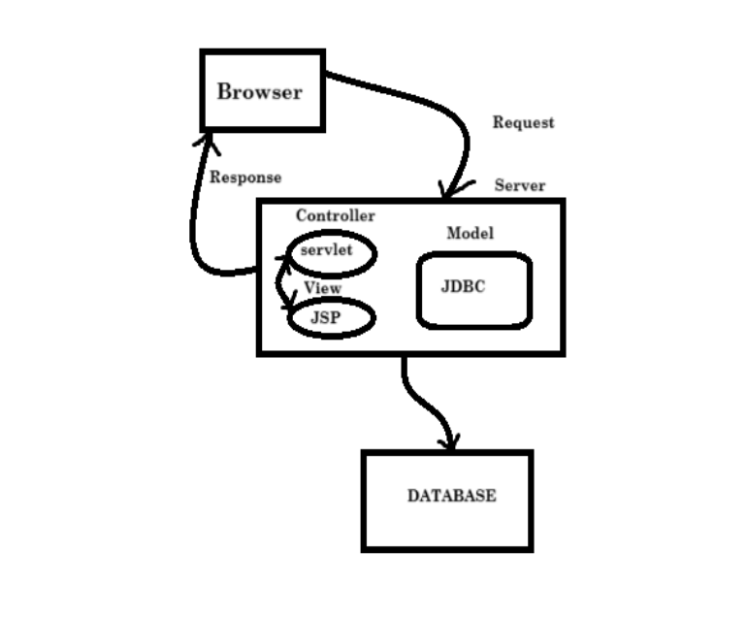
Application Architucture

Slide 6
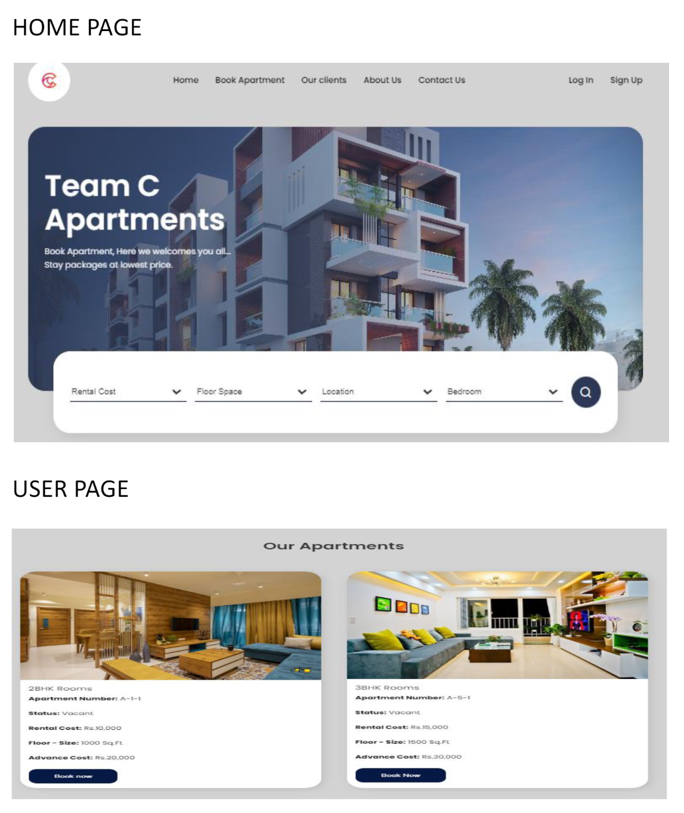
User Interface

Slide 7
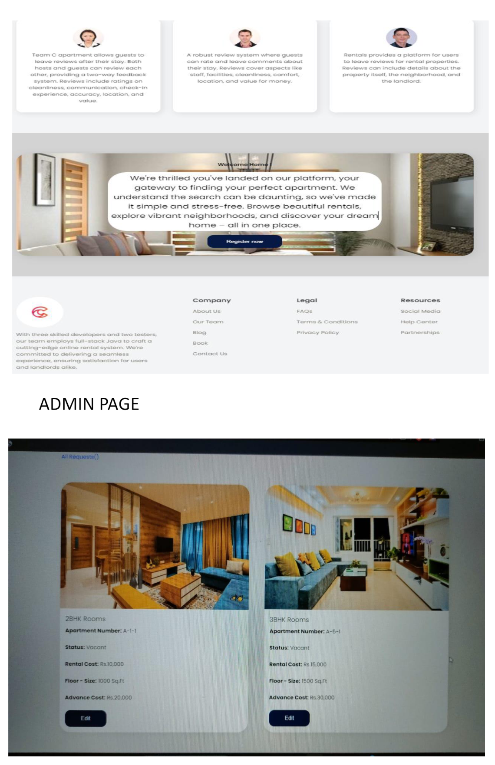
User Interface

Slide 8
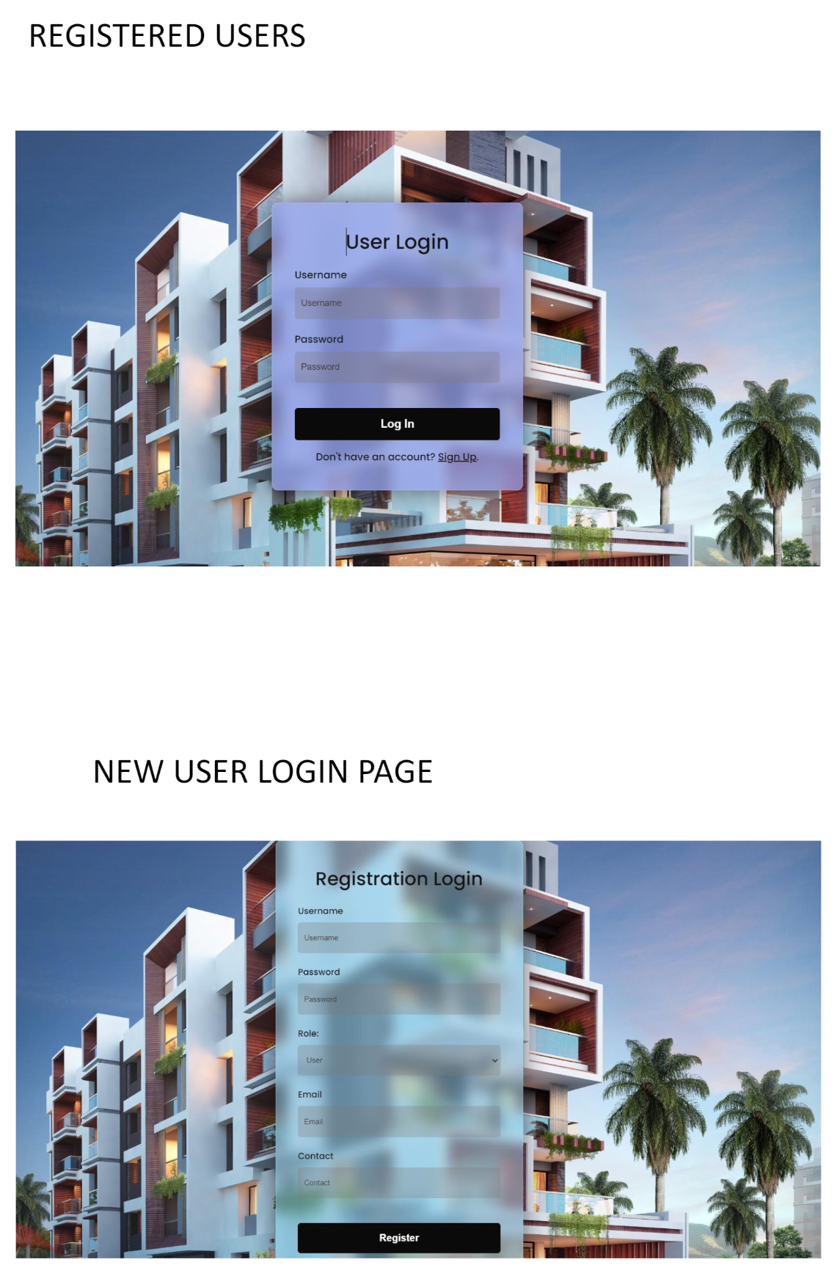
User Interface

